Slide 2
Developing a Privacy Compliance Program
Staying in Compliance in a Rapidly Changing Landscape

Slide 3

Raoul Miller
Director, Content Strategy & Advisory
TEAM IM
raoul.miller@teamim.com
@ECM_Raoul

Slide 4

TEAM IM
Content and unstructured data specialists since 1999
Oracle, M-Files, Microsoft, Elasticsearch, HelloSign, Frevvo, ABBYY, Smartlogic partners
Operate in US, Canada, Australia and New Zealand
Advisory and Strategy practice is one part of what we do.

Slide 5

Agenda
What’s your goal?
What is GDPR?
Who is covered?
What data is covered?
Staying in compliance
(© Raoul Miller)

Slide 6
Better be despised for too anxious apprehensions than ruined by too confident security.
‘’
-- Edmund Burke,
Philosopher and Statesman

Slide 7
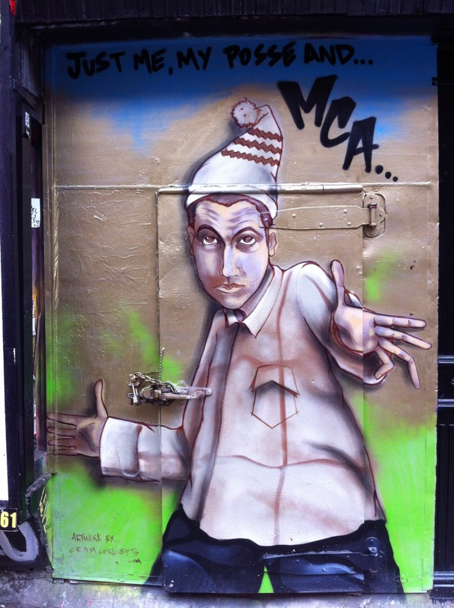
What’s Your Goal?
Do you need to be compliant?
Staying ahead of the curve?
General best practice
Understand your goals first
Make a plan
Execute that plan
(© Raoul Miller)

Slide 8
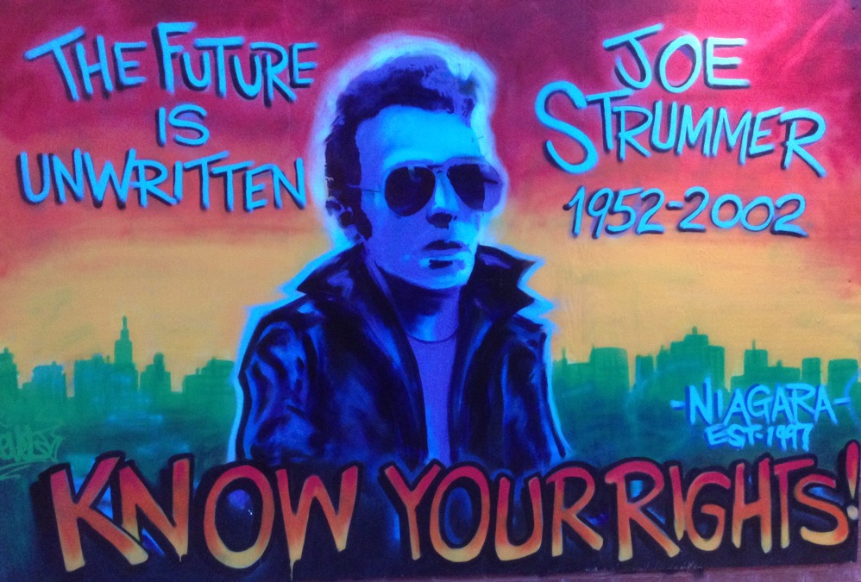
GDPR – General Data Protection Regulation
Came into effect May 2018
EU / EEA / ”EU Data Subjects”
Principles
Lawful purpose for data
Consent & ability to withdraw
“Appropriate measures”
Disclosure and right to request
Date protection and breach reporting
(© Raoul Miller)

Slide 9
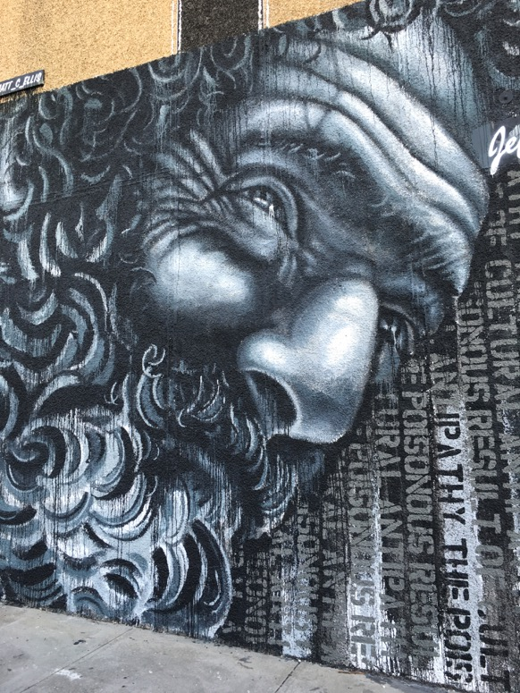
CCPA – California Consumer Privacy Act
Came into effect 1/1/20
California residents
Principles
Disclosure of data collection
Ability to opt out of sales
Access to personal data
Request to delete data
(© Raoul Miller)

Slide 10
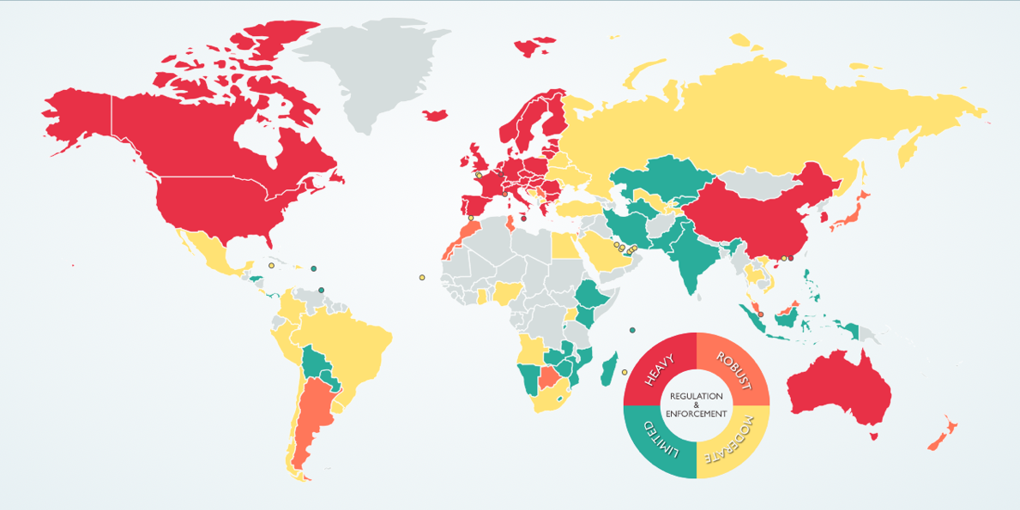
Other Countries and Jurisdictions
Canada – PIPEDA (2001)
Korea – PIPA (2011/20)
Japan – APPI (2003/17)
Australia – Privacy Act (1988)
China – Cybersecurity Law (2017)
Argentina – PDPL (2017)
Etc….
Map from DLA Piper (https://www.dlapiperdataprotection.com)

Slide 11
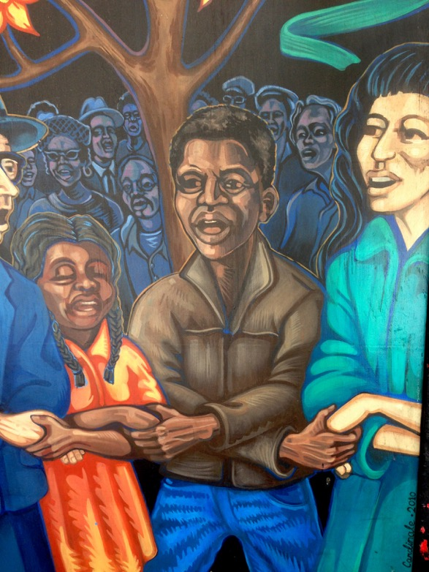
Bottom Line
Privacy legislation is a growing issue
It will eventually cover your org
Plan and start now
Put platforms and processes in place
(© Raoul Miller)

Slide 12

Who is Covered?
Varies depending on law
Assume it’s anyone you are keeping data on
If you are concerned seek legal advice – It’s complicated
(© Raoul Miller)

Slide 13

What Data is Covered?
Also varies based on which law
Some common themes
“Personal Data” – any information related to an identified or identifiable natural person
Name
ID number
Address (including IP address)
Phone number
Username
CCPA excludes publicly available information. Other laws do not
(© Raoul Miller)

Slide 14
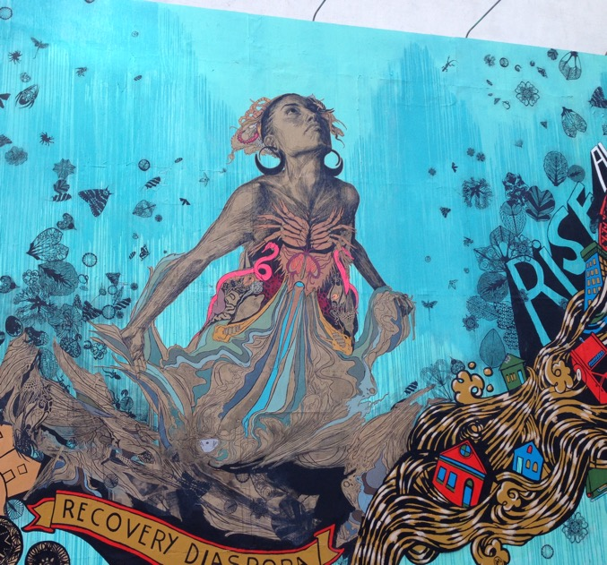
How to Stay Compliant
Identify the data you have
Put systems in place to manage it
Records management platform and processes
Security and ownership on all data
Identify data roles within your org
Reporting and monitoring
Audit
Access
(© Raoul Miller)

Slide 15

Staying Compliant 2 - Platforms
Where is your customer data?
Database?
Managed systems?
Unmanaged systems – File Shares / Excel / CSV?
How do you report on data?
How do you search / expire / delete data?
You need good answers to all of these questions
(© Raoul Miller)

Slide 16

Staying Compliant 3 - Processes
Rethink how you collect, store, and manage personal data
Put in place processes to:
Securely age and delete data
Justify data collection
Respond to data access requests
Respond to audit enquiries
Identify these roles:
Data protection officer
Data controller
Security responsibilities
Usage responsibilities
(© Raoul Miller)

Slide 17
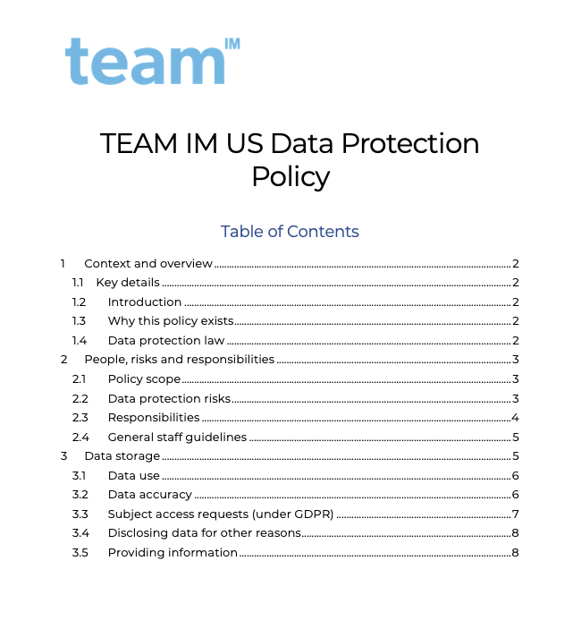
Example Data Protection Policy
Some basic policy documents will help you
Data protection policy
Security policy
Data classification policy
Retention policy

Slide 18
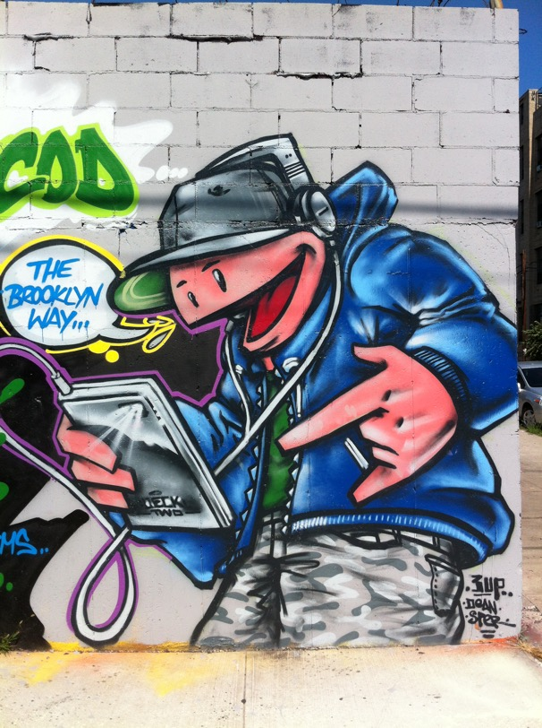
Key Takeaways
Privacy compliance is important and widespread
Costs of non-compliance are high ($$ and reputation)
It’s not difficult to get started
Identify your data
Store on managed platforms
Create / define processes
Document policies
Monitor and manage
Good luck!
(© Raoul Miller)

Slide 19
Questions?
Raoul Miller
Director, Content Strategy and Advisory
TEAM IM
raoul.miller@teamim.com
@ECM_Raoul (Twitter)

